Slide 1

End-to-End Event Management (E2EEM)
Task Force Update
BOD Meeting
January 2012
Ed Tsuzuki

Slide 2
Task Force Members
Lisa Baumann, Metropolitan
Richard Hess, Colorado
Emmett Hines, Gulf
Anna Lea Matysek, National Office
Jim Matysek, National Office, IT
Steve Peterson, Pacific Northwest
Jeanne Seidler, Wisconsin
Luke Shaheen, National Office, IT
Chris Stevenson, Virginia
Ed Tsuzuki (Chair), New Jersey
Mary Beth Windrath, Adirondack

Slide 3
Agenda
Overview
Status
Demo
Next Steps and Opportunities

Slide 4
Overview
All web support services for USMS events - from beginning to end.
Pre-Event
Post-Event
Meet Sanctions
Meet Entry
Meet
Meet Results
Reporting
Calendar of Events
Pre-Meet Info
Real-time Results
Meet Results Database
Top “N”;
Individual Tracking
Data is tied together
Connected to membership database
Complete visibility for all members

Slide 5
Status
Pre-Event
Post-Event
Calendar / Sanction
Entry
Event
Results
Reporting
Completed and Operational
  Event results upload for pool meets
  Swimmer validation in event results
  Event rankings for pool events
  Top ten file generation by LMSC (individual and relay)
  On-line training tutorials
  Web service for event entry member validation
  Web service for member results lookup for event entry seed times
  Event entry services through three sources (Club Assistant, USMS for nationals, Rick Osterberg for NE)

Slide 6
Status
Pre-Event
Post-Event
Calendar / Sanction
Entry
Event
Results
Reporting
Completed and ready to launch
  Enhanced calendar of events display and search
  Sanction/Recognition request
    Pool (Meets)
    Open Water
    Other
  Local (LMSC Sanctions Chair) approvals
    Email notifications
  Training Tutorials
  Event entry services from Active.com

Slide 7
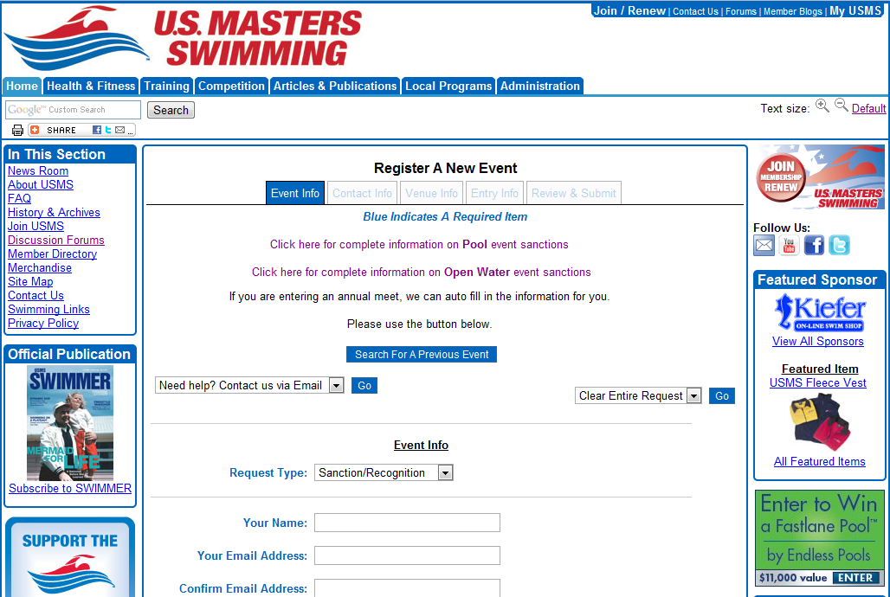
Demo

Slide 8
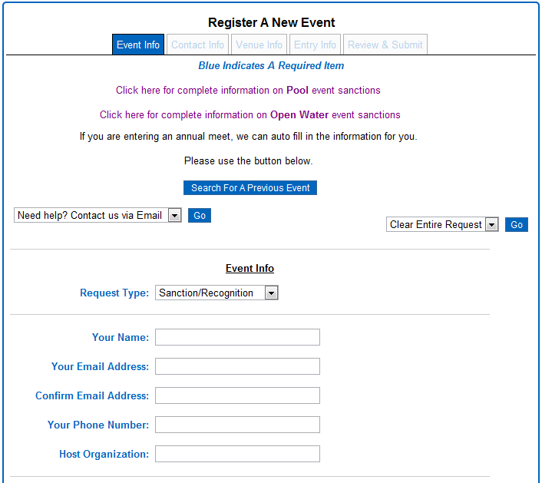
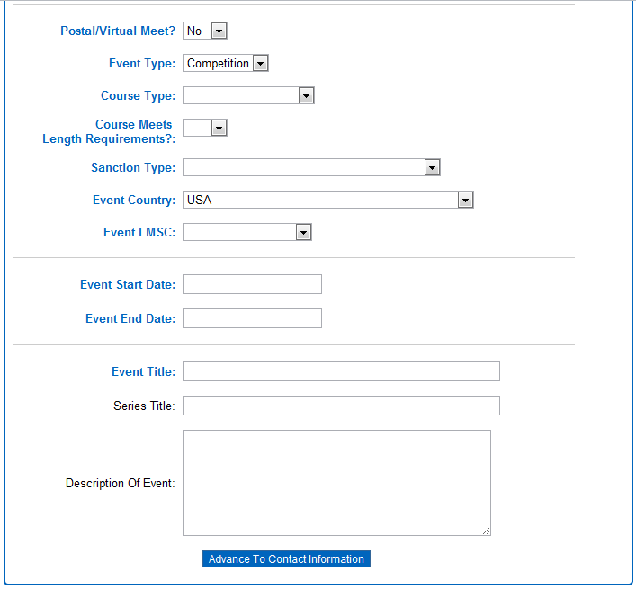
Event Info

Slide 9
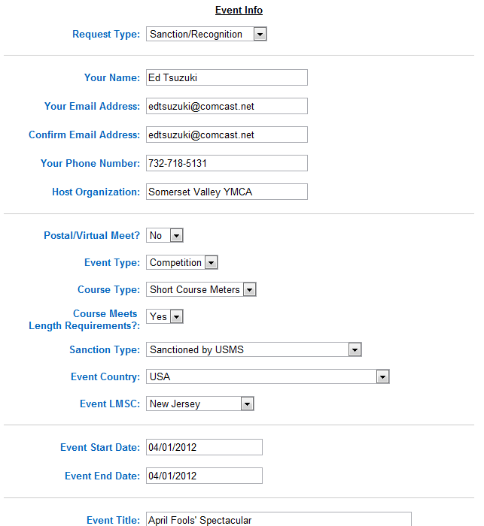
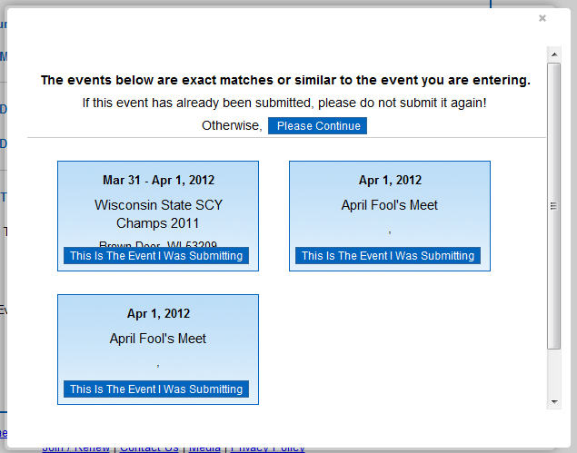
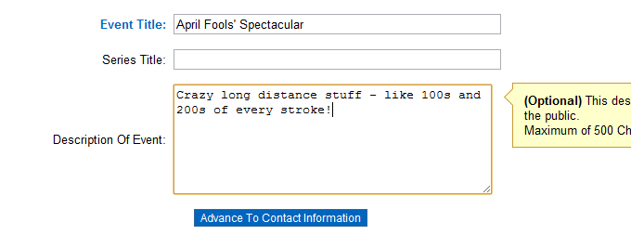
Event Info

Slide 10
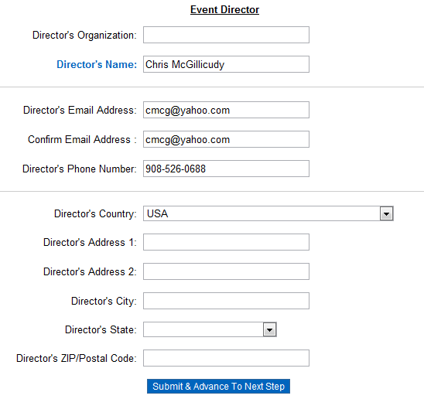
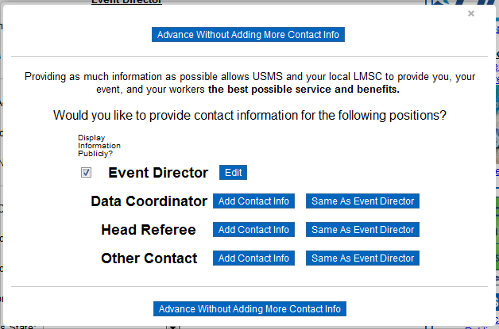
Contact Info

Slide 11
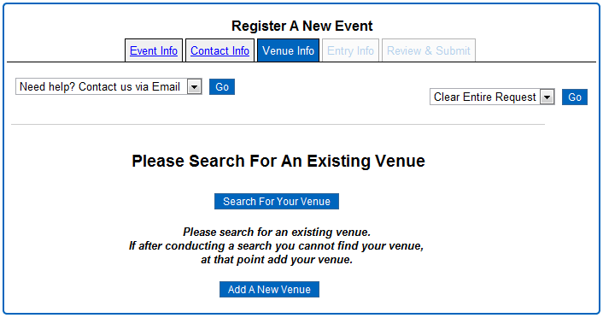
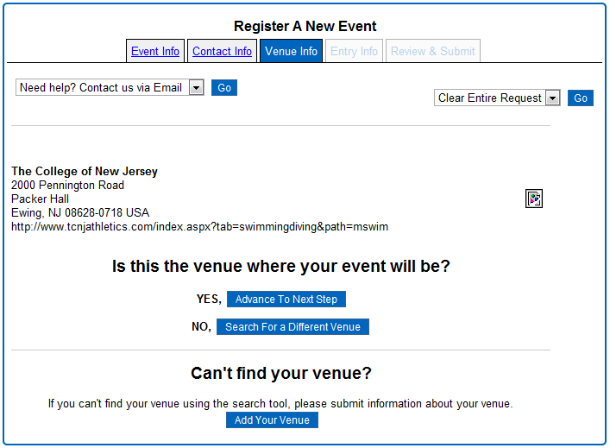
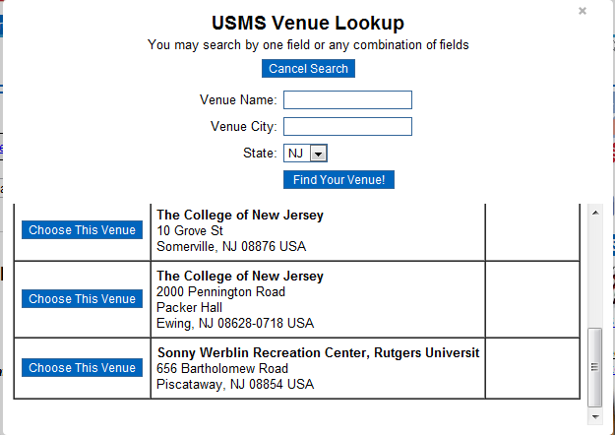
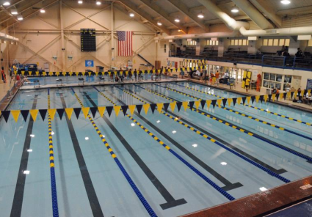
Venue Info

Slide 12
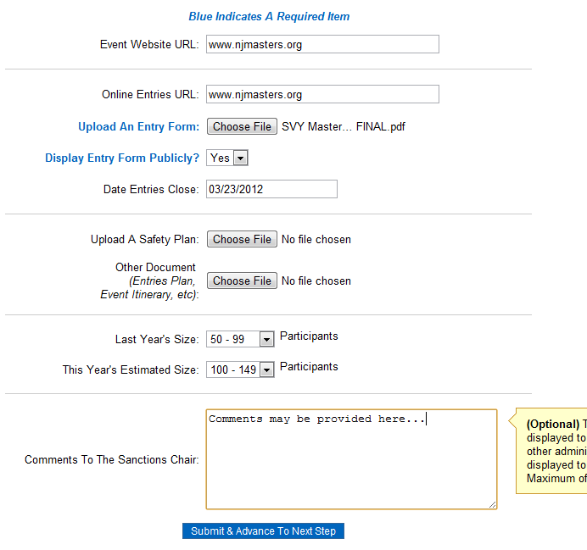
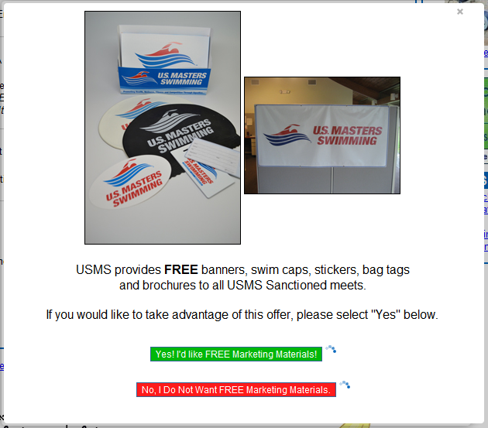
Entry Info

Slide 13
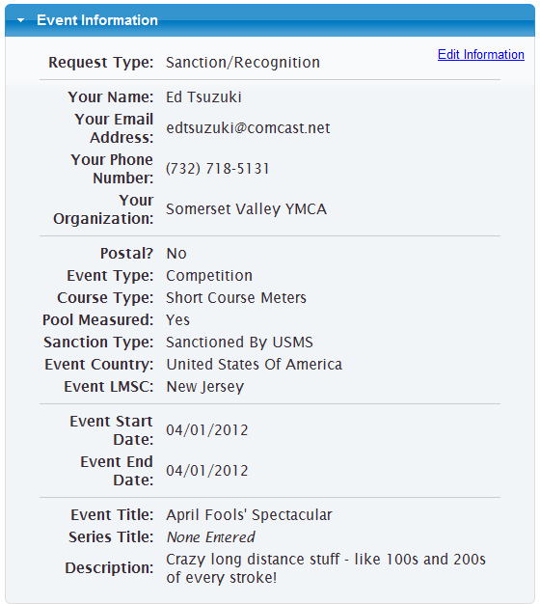
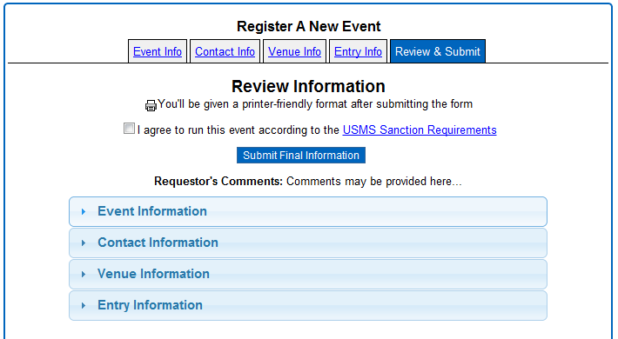
Review & Submit

Slide 14
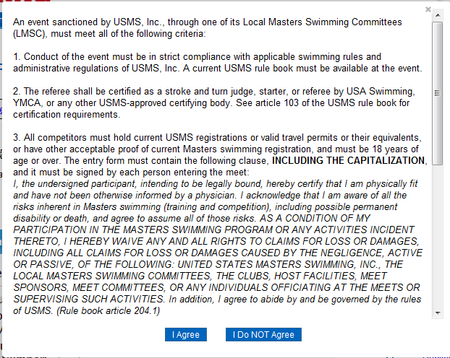
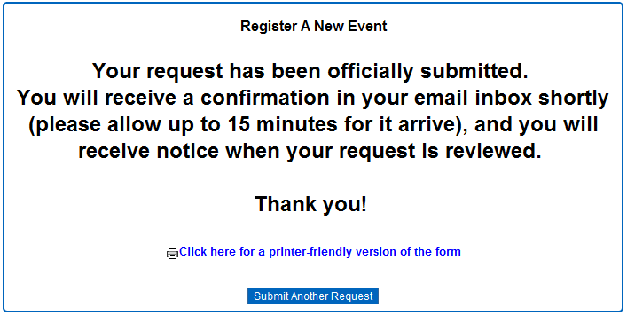
Review & Submit

Slide 15
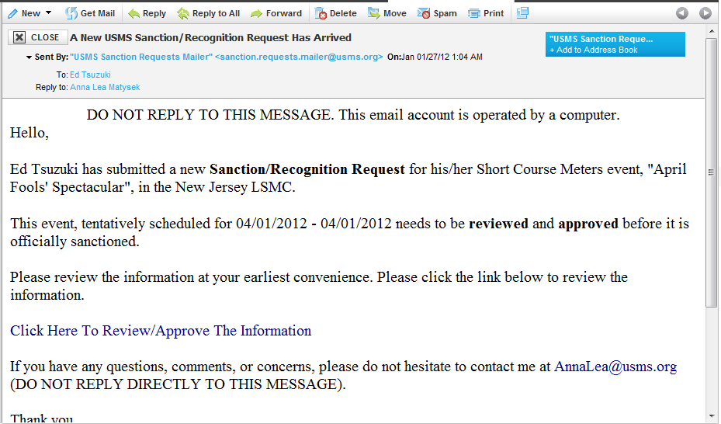
Approval Process

Slide 16
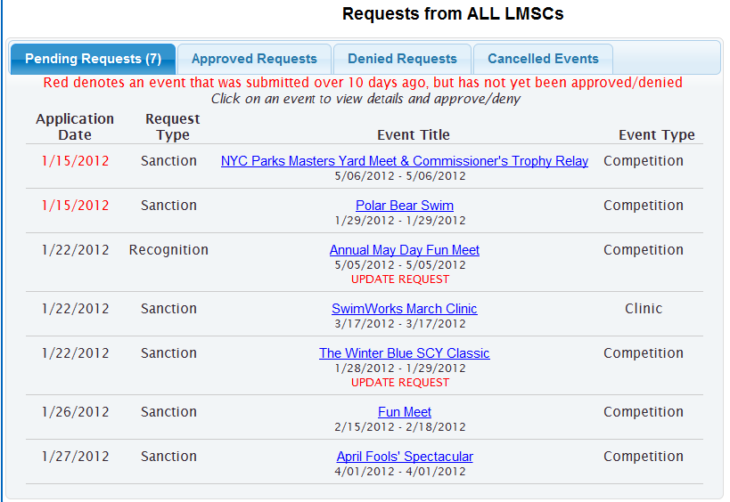
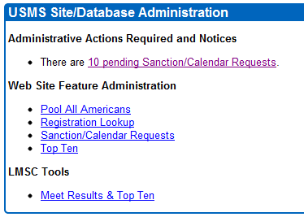
Approval Process

Slide 17
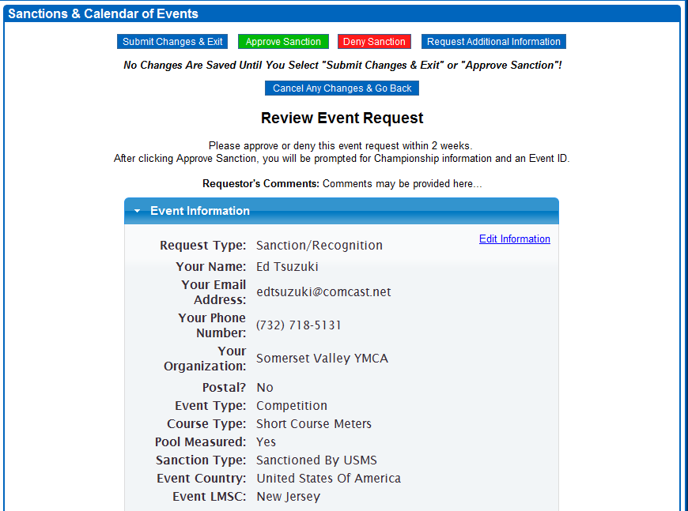
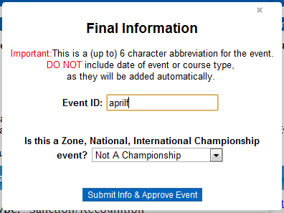
Approval Process

Slide 18
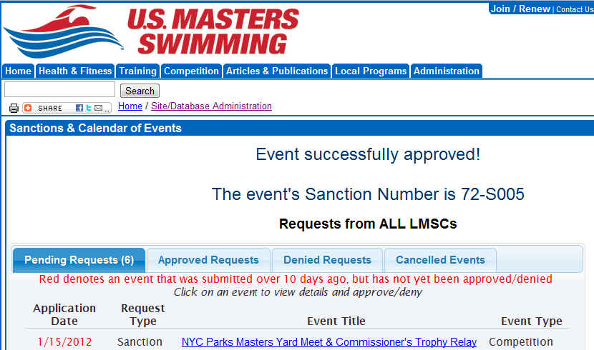
Approval Process

Slide 19
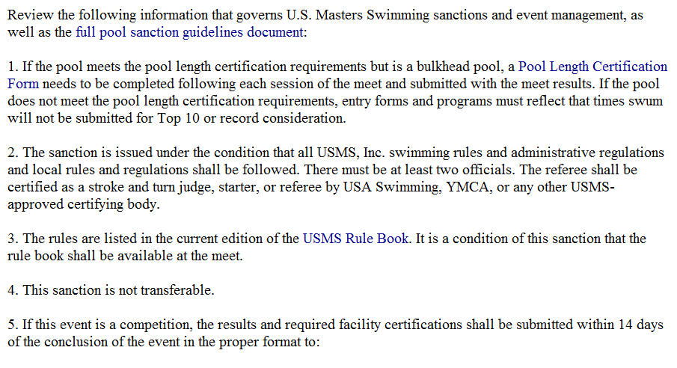
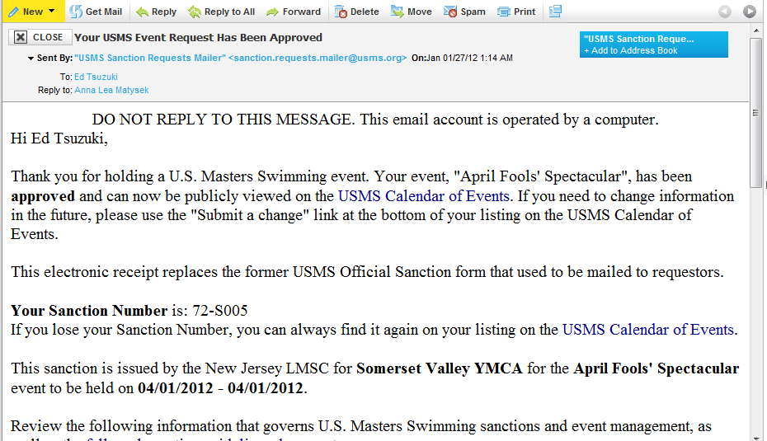
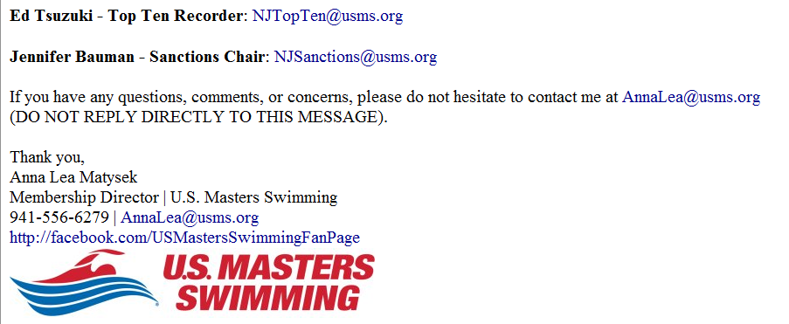
Confirmation

Slide 20
Confirmation

Slide 21
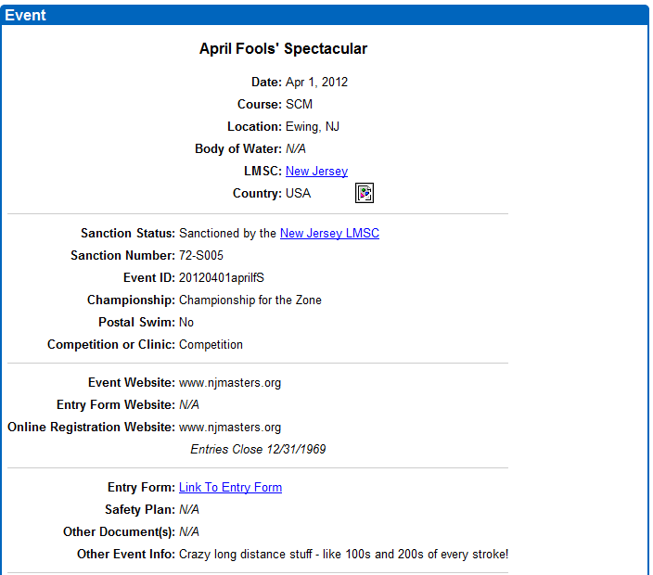
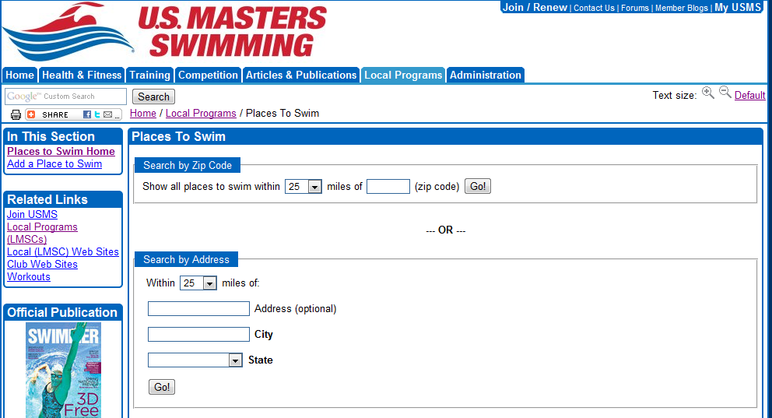
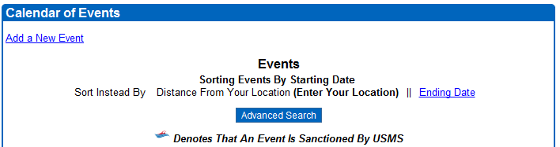
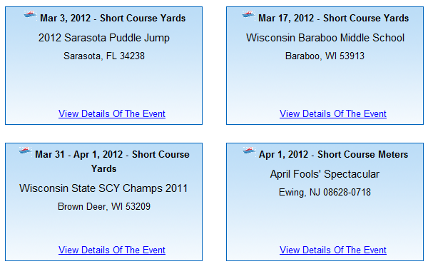
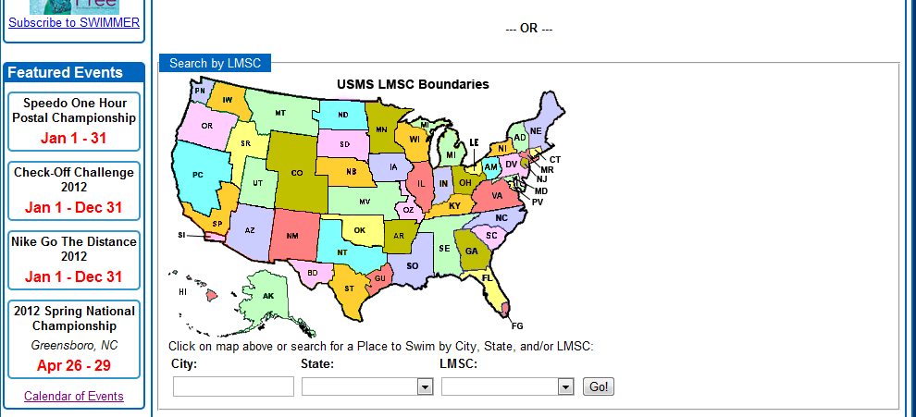
Calendar of Events

Slide 22

End-to-End Event Management
Integrated data from beginning to end
100% inclusion of participating membership
Comprehensive and enhanced event calendar
Greater consistency in sanctions process
Validation of USMS membership
Improved visibility for all members and the national office
Heightened awareness of, and compliance to, rules
Pre-Event
Post-Event
Meet Sanctions
Meet Entry
Meet
Meet Results
Reporting
Calendar of Events
Pre-Meet Info
Real-time Results
Meet Results Database
Top “N”;
Individual Tracking

Slide 23
Next Steps & Opportunities
Launch the new calendar of events/sanction request application
  Announcement scheduled for 31-Jan-2012
  Provide on-line tutorials
  Offer one-on-one customer support, if requested
Leadership to encourage usage – especially within one’s LMSC
Monitor
  Track usage
  Follow-up with inactive LMSCs; provide support as needed
  Gather feedback from users
Plan for Phase 2
  Add ability to include postal and open water events results
  Implement open water point and ranking system
  Incorporate record recognition into results processing

Slide 24
Thank you!

